Slide 1
Fast Bilateral-Space Stereo for
Synthetic Defocus
Team PIX-IT
Mentor TA : Meher Shashwat Nigam
Team Members:
Apoorva Thirupati (2019121012 - DD CS)
Balavarun P(2020701012 - MS CS)
Mohd Omama (2020701006 - MS CS)
Jhanvi Shingala (2020701008 - MS CS)
GitHub Repo Link

Slide 2
A General Taxonomy of Stereo Algorithms
[3] A Taxonomy and Evaluation of Dense Two-Frame Stereo Correspondence Algorithms
A vast majority of stereo algorithms use a subset of following approaches:
Stereo Matching
Cost Aggregation
Disparity Optimization
Local Methods: Stereo Matching + Cost Aggregation
Global Methods: Stereo Matching + Disparity Optimization
This Paper: Stereo Matching + Disparity Optimization in Bilateral Space

Slide 3
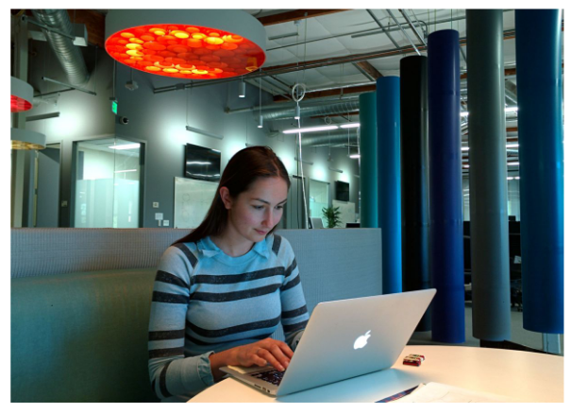

High Level Overview
Get disparity map and confidence from Stereo Matching
Develop technique to make Bilateral Filtering fast. This technique helps us to go from Pixel to Bilateral Space.
Solve for depth in Bilateral Space

Slide 4
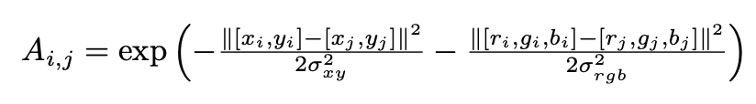
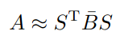
Fast Bilateral Grid
The normal bilateral grid formation equation - timetaking & slow
Faster way to calculate bilateral grid, A, represented as product of sparse matrices:
Where S is the “splat”, multiplication by B is the “blur” and by S transpose is the “slice”.

Slide 5
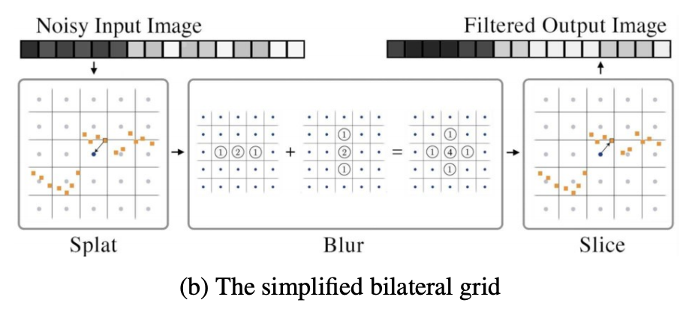
Fast Bilateral Grid
Splat Matrix
Image pixels mapped to a 5-dimensional space (x, y, Y, Cr, Cb)
Hashing applied to get unique coordinates which represent vertices
Creating a sparse splat matrix to go from pixels to vertices
Slice
Transpose of splat

Slide 6
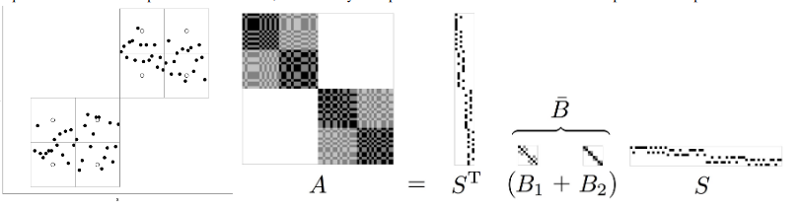
Fast Bilateral Grid
Blur Matrices
Simplifying the creation of blur matrix to the addition of sparse matrices(instead of multiplication) .
This is faster than multiplication but compromises for accuracy.

Slide 7
Formulation of Optimization Problem in Bilateral Space

Slide 8
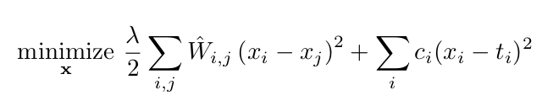
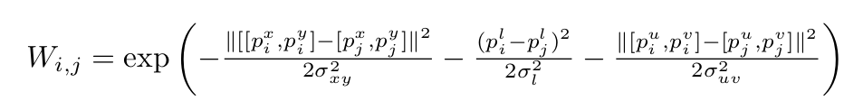
Revisiting Problem in Pixel Space
Objective in pixel space is a combination of data and smoothness terms:
--(1)
ti, ci are target and confidence values obtained from stereo matching
W matrix represents measure of smoothness
In our case, W_hat is bistochastic version of Bilateral Matrix W:
--(2)

Slide 9
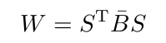
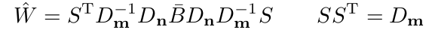
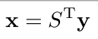
From Pixel to Bilateral Space
Approximating W using Splat, Blur, and Slice Matrices
--(3)
Bistochastization of W. (Pseudo code in paper)
--(4)
Variable Substitution. Going from pixel to vertices (Bilateral Space)
--(5)

Slide 10
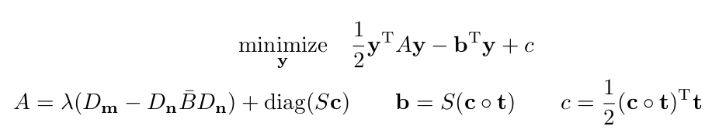
Final Problem in Bilateral Space
Substituting (4) and (5) in (1), our problem in Bilateral Space becomes:
Advantages:
y << x, Hence fast
Edge aware depth
Useful for defocus applications

Slide 11
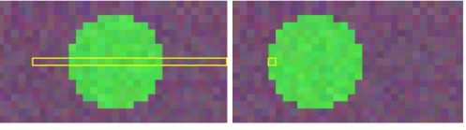
Stereo Matching (Scratching The Surface)
Approaches:
Per-Pixel
SSD (Sum of Squared Difference)
SAD (Sum of Absolute Difference)
Block Matching (Aggregation)
Using Birchfield-Tomasi Measures
Stereo Matching in Rectified Images

Slide 12
Results

Slide 13
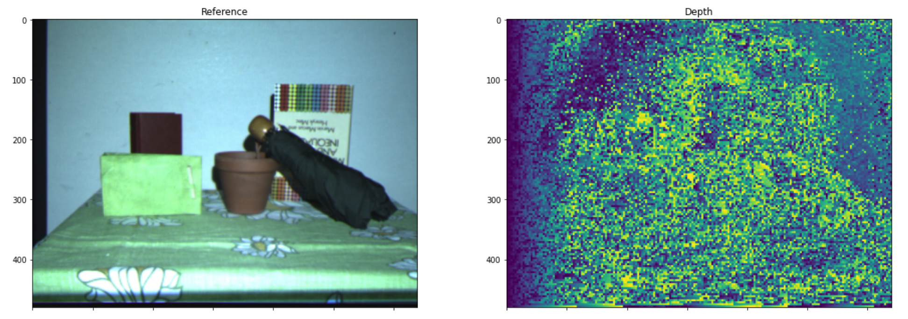
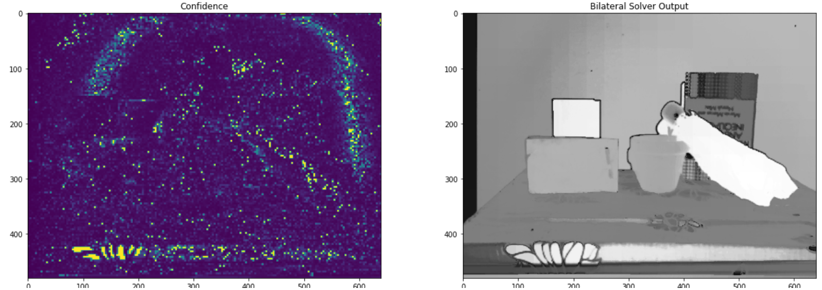

Slide 14
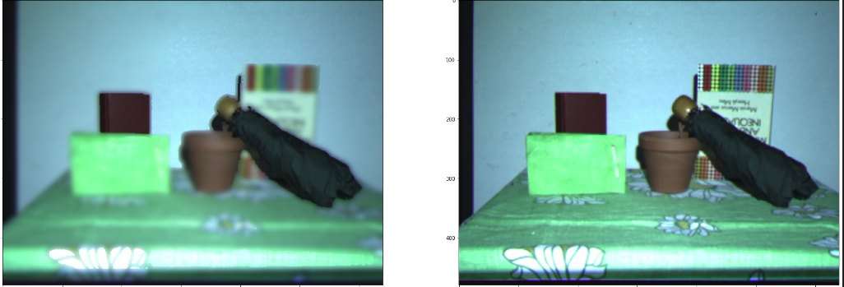
Synthetic Defocus
Synthetically Defocused Image
Reference Image

Slide 15
Conclusion
Pros:
Edge aware stereo optimization
Considerably fast
Ideal for synthetic defocus use case
Cons :
Cannot be used for fine resolution of depth
Not ideal when multiple objects present in foreground
Scopes of Improvement :
Different stereo algorithms can be used to generate disparity map
Other ways of generating splat matrix
Testing on benchmark datasets

Slide 16
References
Jonathan T. Barron, Andrew Adams, YiChang Shih, Carlos Hernandez, Fast Bilateral Space Stereo for Synthetic Defocus, CVPR 2015
Jonathan T. Barron, Andrew Adams, YiChang Shih, Carlos Hernandez, Fast Bilateral Space Stereo for Synthetic Defocus Supplemental Material, CVPR 2015
Daniel Scharstein and Richard Szeliski, A Taxonomy and Evaluation of Dense Two-Frame Stereo Correspondence Algorithms, IJCV
Jonathan T. Barron and Ben Poole , The Fast Bilateral Solver, ECCV 2016
Stan Birchfield and Carlo Tomasi, Depth Discontinuities by Pixel-to-Pixel Stereo, IJCV 1999

Slide 17
Work Distribution
Balavarun:
Bilateral Grid
Splat, Blur, Slice Matrices
Defocus
Omama
Bilateral Grid
Splat, Blur, Slice Matrices
Bilateral Solver
Code Integration
Final Testing, Parameter Tweaking
Apoorva:
Stereo Matching (Per Pixel)
Testing Different Approaches of Stereo Matching
Slides, Documentation
Jhanvi :
Stereo Matching
Birchfield Tomasi, Sum of Squared Difference
Block-Matching Interval Cost Volume

